Slide 1
“EDIFUNGI” Mushroom Classification
Presenting By,
Subham Patel

Slide 2
CONTENTS
01
Problem Statement & Approach
02
Exploratory Data Analysis
03
Data Preprocessing
04
Model Building & Comparison
05
Prediction Metrics
06
Conclusion & Recommendation

Slide 3
01
Problem Statement & Approach

Slide 4
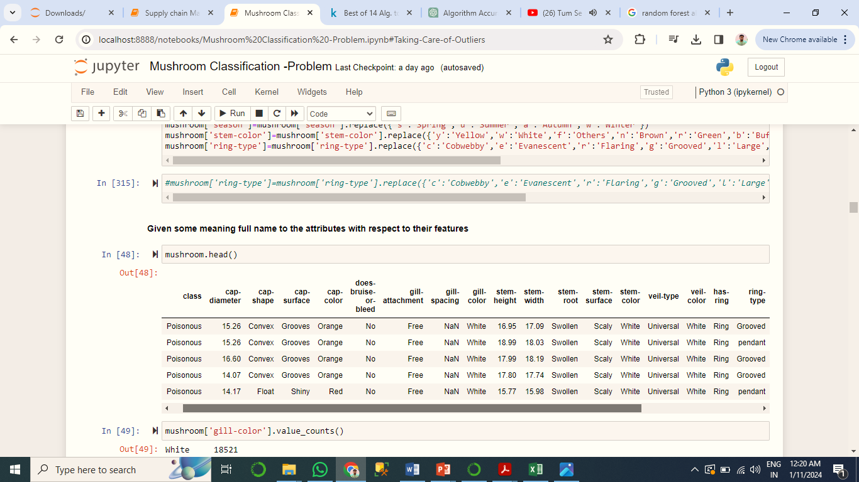
Problem Statement & Approach
To prepare Machine learning model which will safeguard the mushroom foragers by distinguishing between edible and poisonous mushroom.
The task at hand for us to predict the Mushroom type based on the existing data using machine-learning algorithm.
To study the factors affecting the mushroom, which features are significant and how well those features describe the type of mushroom.
Data
Total No of Rows:-61244 , No of Columns-23

Slide 5
Strategy
DATA
DESCRIPTION
UNIVARIATE
ANALYSIS
BIVARIATE
ANALYSIS
DATA
PREPROCESSING
MULTIVARIATE
ANALYSIS
Model
Building
PREDICTION &
EVALUATION
DATA GATHERING
BOX PLOTS
BAR CHART (HUE)
MISSING VALUE TREATMENT
HEAT MAP
SPLITING
DIFFERENTIATING
VARIOUS ALGO
CLEANED THE DATA
DISTRIBUTION
PLOT
COUNT PLOT (HUE)
OUTLIER TREATMENT
FEATURE
SCALING
SELECTION OF
BEST MODEL
MERGED DATASETS
KDE PLOT
MODEL TRAINING & TESTING
SAVING THE
MODEL
COUNT PLOT
REMOVAL OF UNNECESSARY DATA
CONCLUSION &
RECOMMENDATION
DATA INFERENCE
RECOMMENDATION

Slide 6

02
Exploratory Data Analysis
EDA is a very crucial ,important part to examine & study the data and get deeper insights .

Slide 7
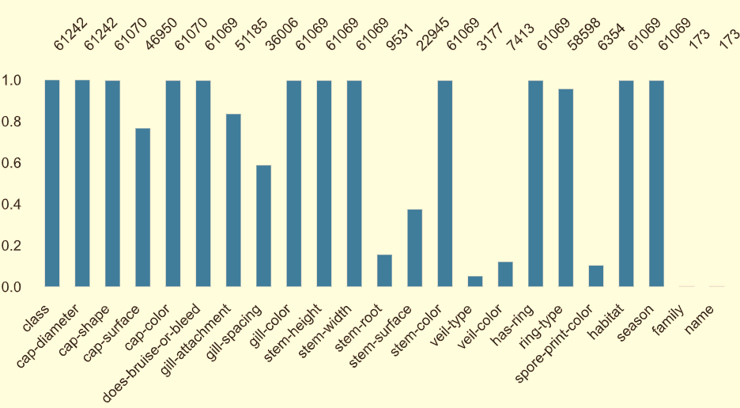
Exploratory Data Analysis(EDA)
Data Dictionary & Analysis
Independent Variables
Dependent Variables
1. Cap-diameter
2. Cap-shape
3. Cap-surface
4. Cap color
5. Does-bruise-or-bleed
6. Gill-attachment
7. Gill- Spacing
8. Gill-Color
9. Stem-height
10. Stem-Width
11. Stem-Root
12. Stem-Surface
13. Stem-Color
14. Veil-Type
15. Veil-Color
16. has-ring
17. Ring-Type
18. Spore-Print-Color
20. Habitat
21. Season
22.Famil.
23.Name
1.Class
Missing Values from Each Column

Slide 8
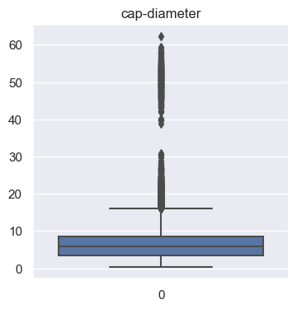
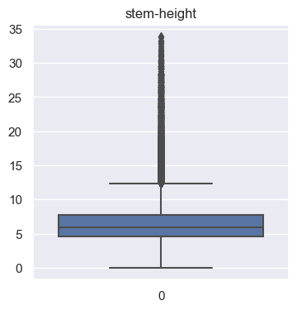
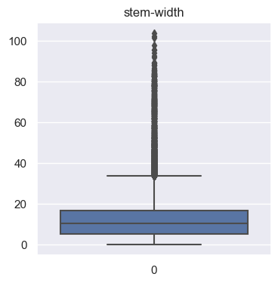
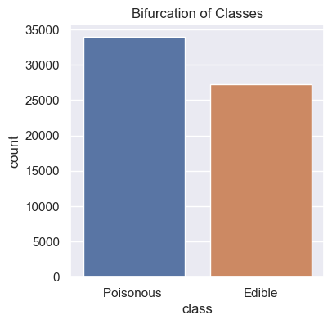
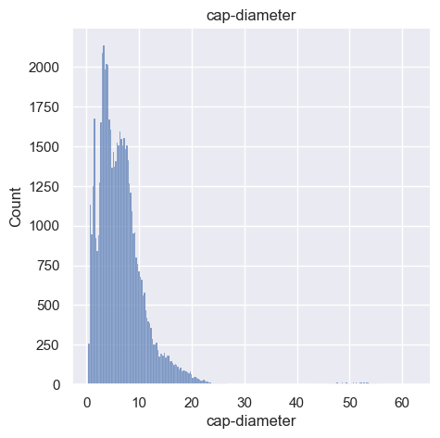
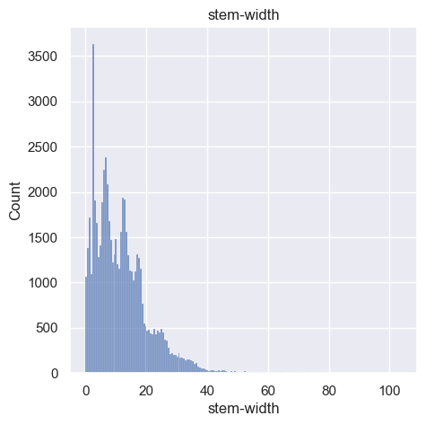
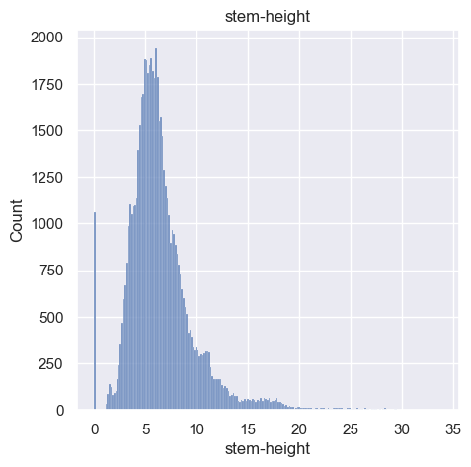
Exploratory Data Analysis
Univariate Analysis
Inference:- (A)From the Distribution plots we can observe that the distribution of Cap-Diameter,stem-height and stem-width are slightly indicating right skewness and the evidence is coming from the boxplot chart.
(B) Mushrooms having poisonous classes are having highest occurance then the Edible one.

Slide 9
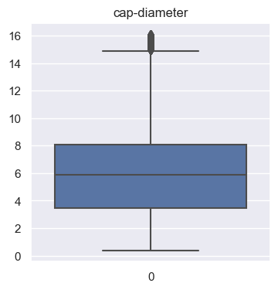
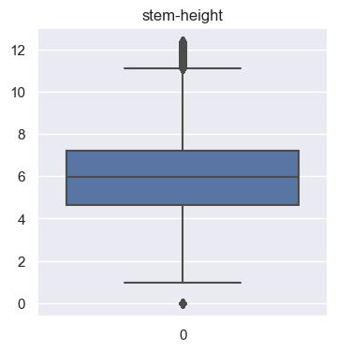
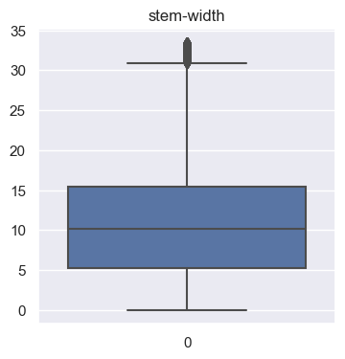
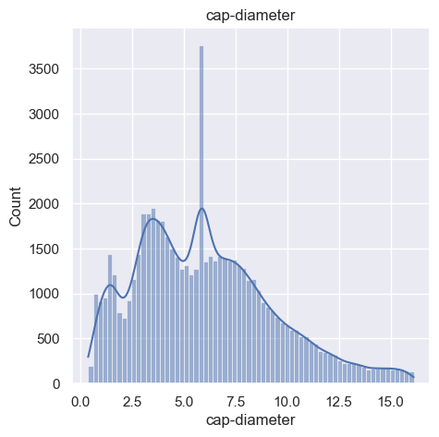
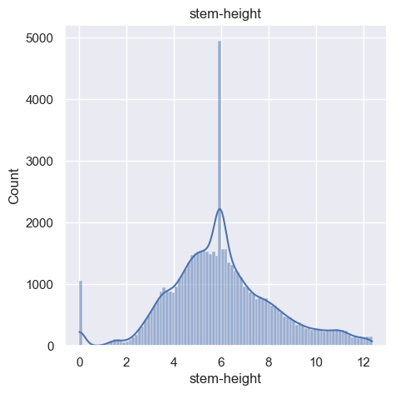
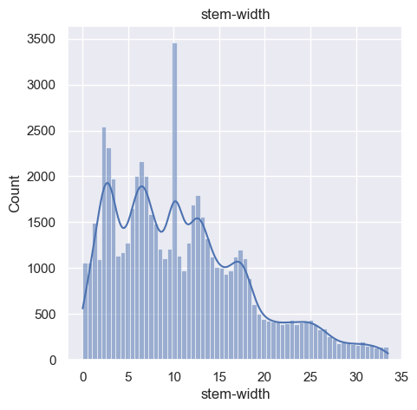
Exploratory Data Analysis
Univariate Analysis
Inference:- (A)From the Boxplots we can observe that the Cap_diameter,Stem-Height ad Stem-Widht has been treated with IQR method
(B)In the below distribution plot we can observe that Stem-height is Normally distributed and Cap Dia and stem-width are slightly have a right knewness still after outlier treatement.

Slide 10
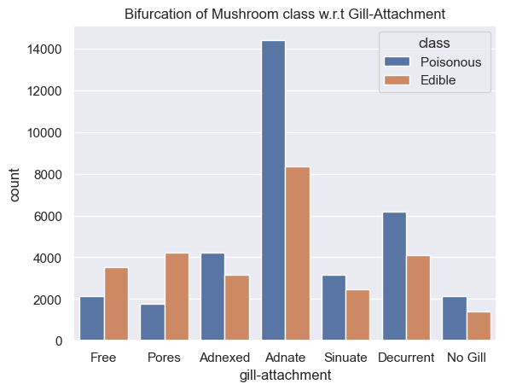
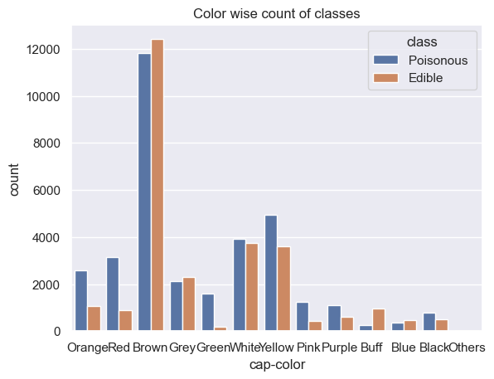
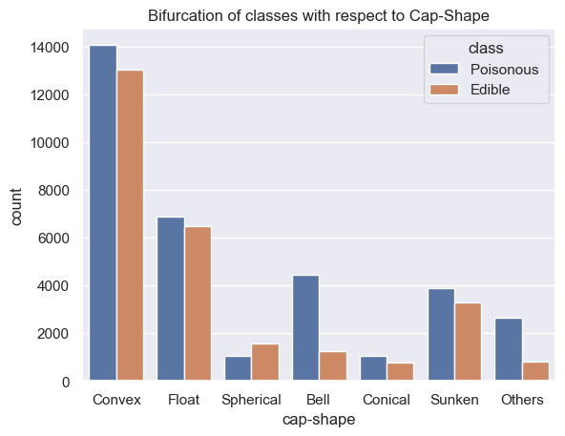
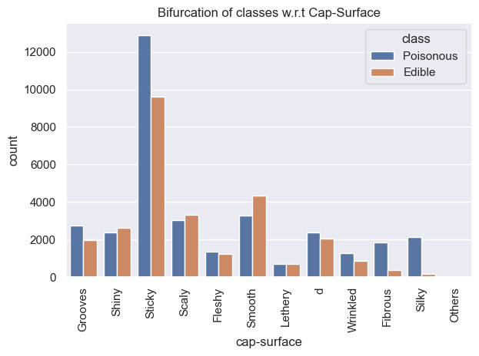
Exploratory Data Analysis
Bi-Variate Analysis
Inference:- (A) Adnate kind of gill attachment are having maximum occurance in the dataset followed by decurrent type gill attachement .
(B) Mushroom having Brown Cap-color are majorly present in the dataset is approx 24000 followed by Yellow and White and Mushrooms having blue cap color are less present in the dataset
(C) Most of the mushroom's Cap shaepe in the provided datasets are convex followed by Float. Conical cap shape are the one who is having least presence in the datasets.
(D) From the visualization chart ,Most of the Mushroom's Cap surface are sticky stil the poisonous mushroom coming under Mushroom which are having sticky cap suraface . In the other side Mushroom 🍄 having Smooth Cap surface are edible and have highest occurence with respect to edible mushroom.

Slide 11
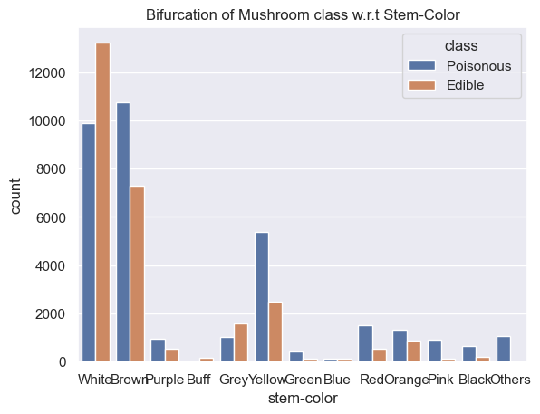
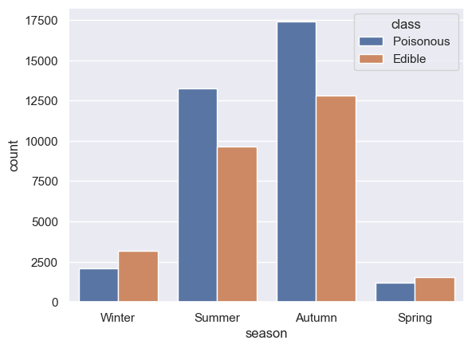
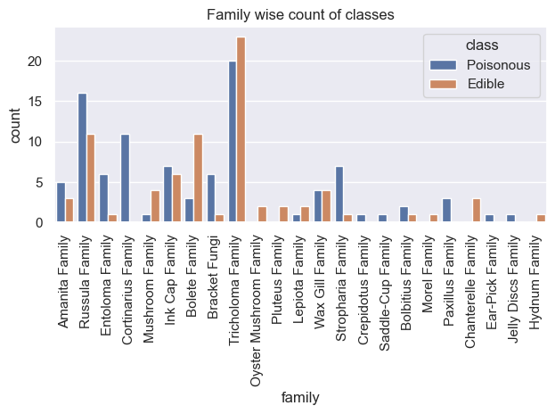
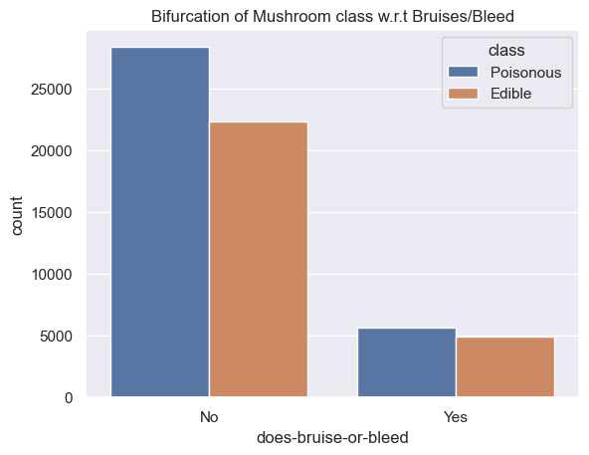
Exploratory Data Analysis
Bi-Variate Analysis
Inference:- (A) From the above chart we can observe that Mushroom having white stem color has the highest occurance in the dataset and Mushroom having Blue stem color are rarely present in the datasets.
(B) As per the above chart we can say "Automn" is the month where we can find most of the mushroom while spring doent have musch produciton to compariing any other season.
(C) Tricholoma Family has the highest presence comparing al other family.Also from the visualisation we can note Cortinarius Family & Stropharia Family belongs to poisonous Mushroom.
(D) Seems like mushroom which doent have any bruise/bleed are more which are good to become edible kind .Even though there highest no of poisonous mushroom in dataset.

Slide 12
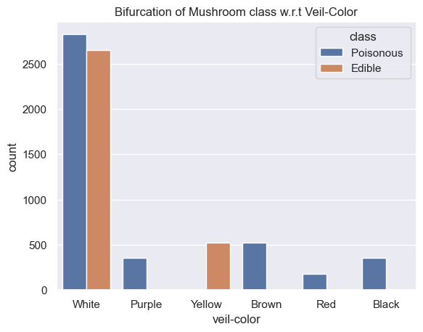
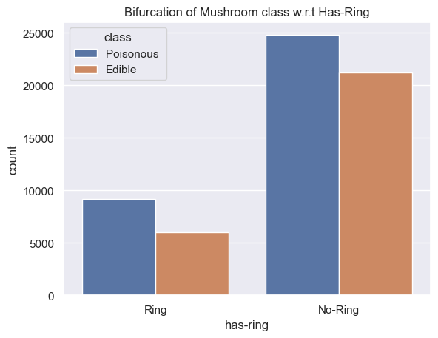
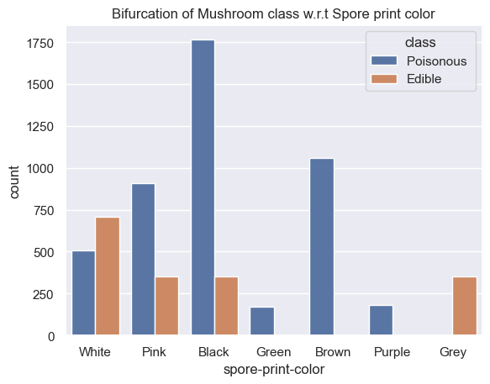
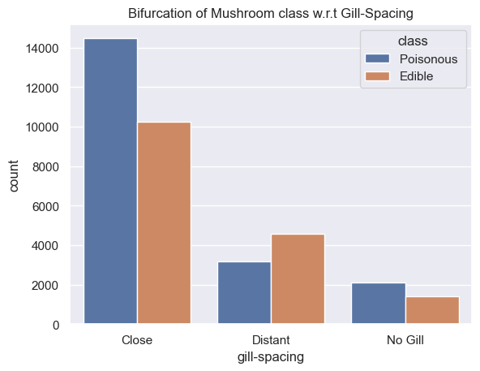
Exploratory Data Analysis
Bi-Variate Analysis
Inference:- (A) Mushroom's having Black,Purple,Brown and Red veil color are clearly seems like to be poisonous only.
(B)Mushroom having No ring are highly present in the dataset.classified along with their class.
(C) Mushroom's having Spore of Grey color are safe to have and in the other hand Brown,Green,Purple,Black are poisonous kind.
(D) From the above visualization chart close gill spacing are strongly presence compairing Distance gill speacing .There are approx 1800 Mushroom which dont have any Gill.

Slide 13
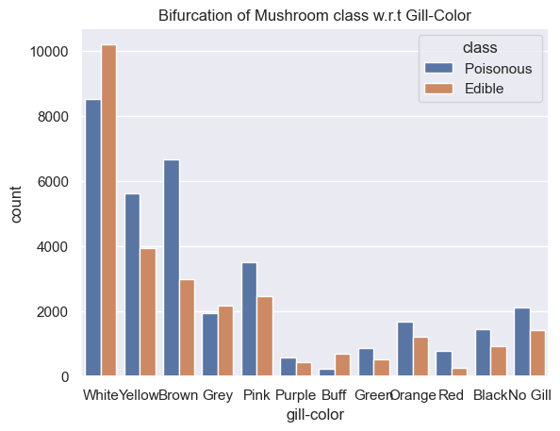
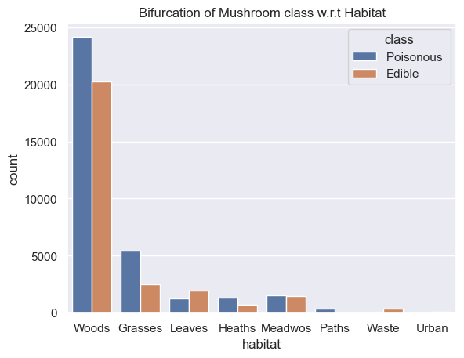
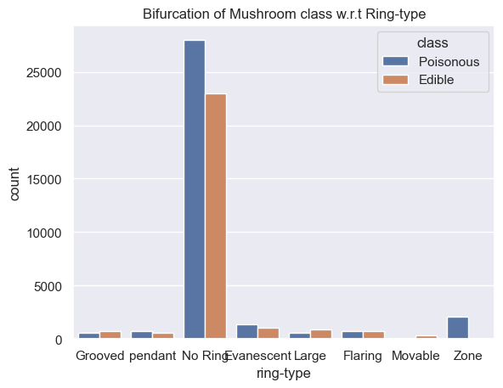
Exploratory Data Analysis
Bi-Variate Analysis
Inference:- (A) Mushroom having White gill color followed by Brown and yellow are taking the highest position as per the above visuaiation.
(B) Most of the Mushroom are seems to be come from Woods and Grasses area.Nothing has been coming from Paths,Urban & Waste Zone.
(C) Mushroom having No Rings are strong having highest presence in the dataset.

Slide 14
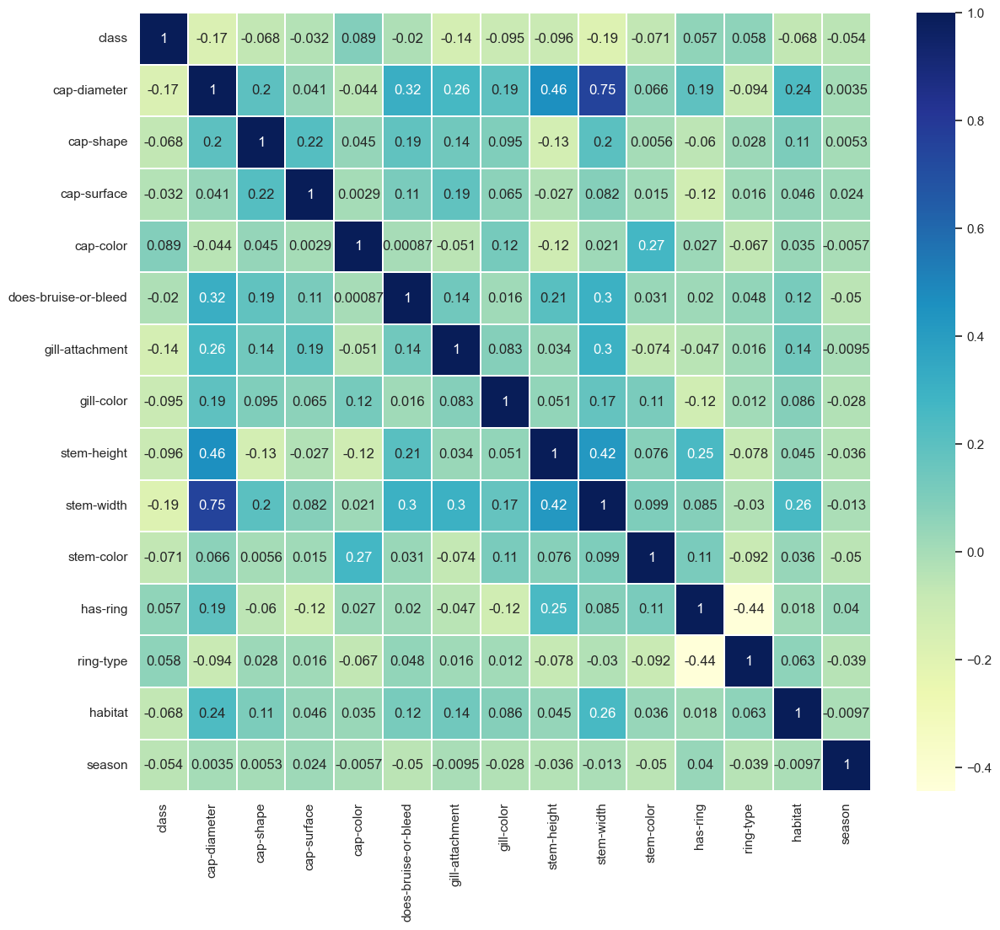
Exploratory Data Analysis
Multivariate Analysis
Heatmap: It is an interactive visualization tool which help us understand the correlation between variables.
Inference:- We found that the relationship and strength between variables which are stem width, stem height, Bruisies/Bleed, Gill-Attachment with Cap Diameter

Slide 15

03
Data Preprocessing
Here In this step we will prepare the data for model building and analysis.

Slide 16
Data Preprocessing
Missing Values:- Column having less than 40% missing values has been imputed with the help of median and mode with respect to Categorical and Numerical Value. The columns on which imputation methods are applied are Cap-Shape, Cap-Surface, Gill-Attachment, Gill-Spacing, Gill-Color, Stem-Width, Stem-Color, Has-ring, Ring-type, Habitat, Season.
Dropping of Columns:- Dropped columns which have missing values more than 40% which are Veil-Colour, Stem-Surface, Stem-, family name, Gill-Spacing, Veil-type , Stem-Root.
Outlier Detection:-After carefully observation with the help of distribution plot and boxplot & few research ,found that there are outlier presence in the dataset which are Stem-Width, stem height, cap –diameter. Which has been replaced with the help of IQR method.
Encoding the data :- Label Encoding is the process to convert the text data into numerical data as machine will only use the numerical data to predict. So here Label encoder has been used for all object dtypes’s column.
Scaling the features:- All the values in the data scale are of differenet scale,In order to remove the bias from the feature we used standat scalar.

Slide 17

04
Model Building & Comparison
This steps basically allows various algorithm to learn from historical data patterns, find out relations. It also provides insights and solutions to complex problems.

Slide 18
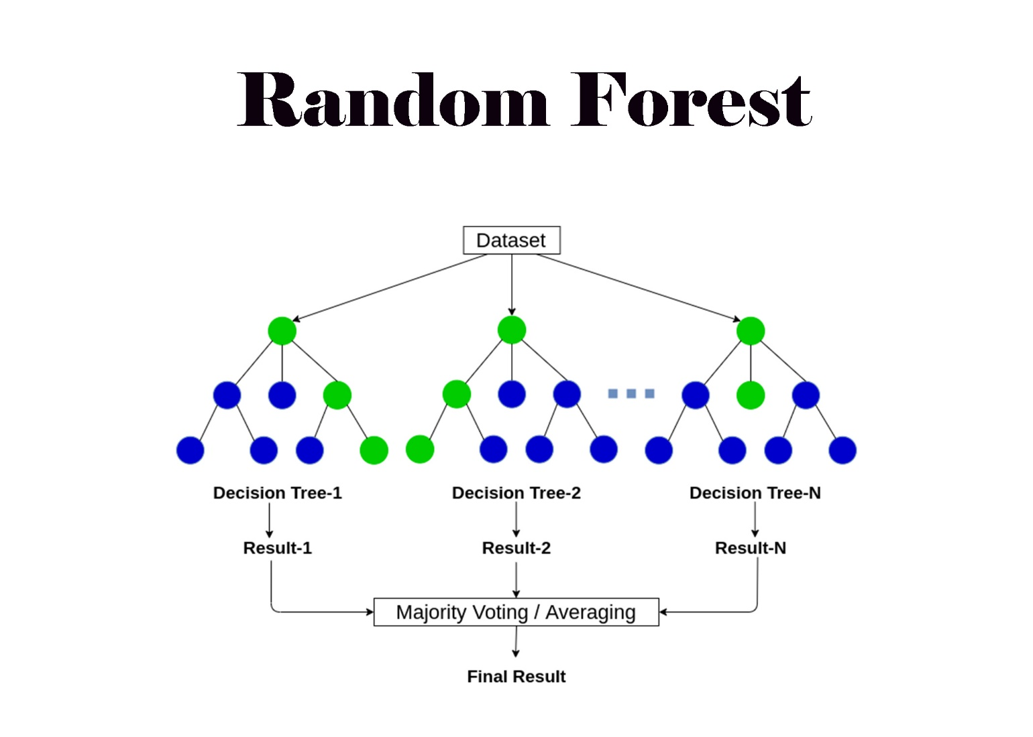
Model Building
Random Forest Machine Learning Supervised Algorithm
It can be used for both Classification & Regression problem
It is an ensemble technique that combines multiple decision trees to train and predict the output.
For the classification task each decision tree gives the output class and the final output class is selected as per voting and if it’s a regression problem then it calculates the average(mean) of all the output.
It can reduce the overfitting problem and can provide high accuracy in th result as it aggregates of multiple decision trees and the reduction of variance and overfitting.
We can check the feature importance with the help of random forest and it can handle large dataset.

Slide 19
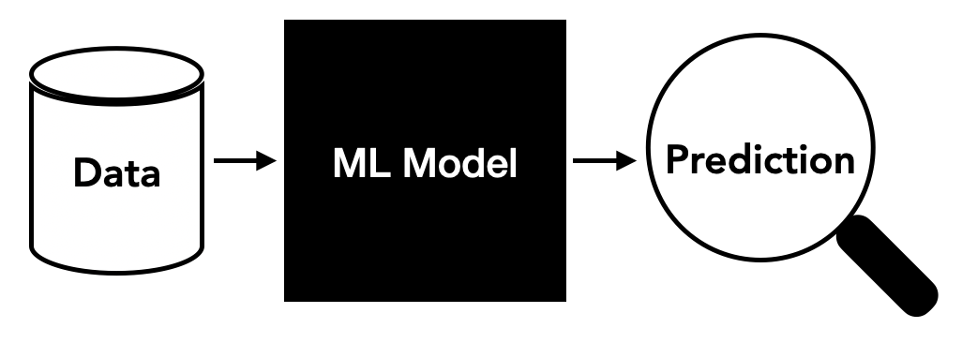
05
Predictions & Matrices
After the successful model building ,here we get prediction of our future data and to measure the accuracy we use matrices .

Slide 20
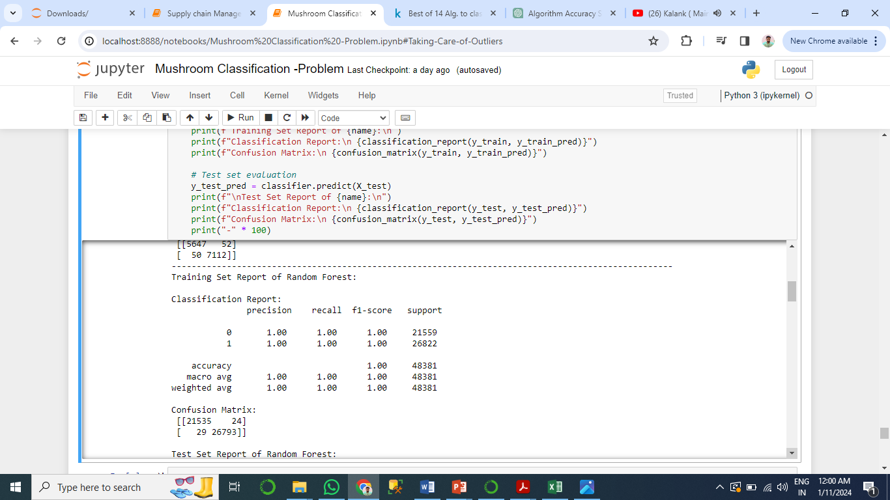
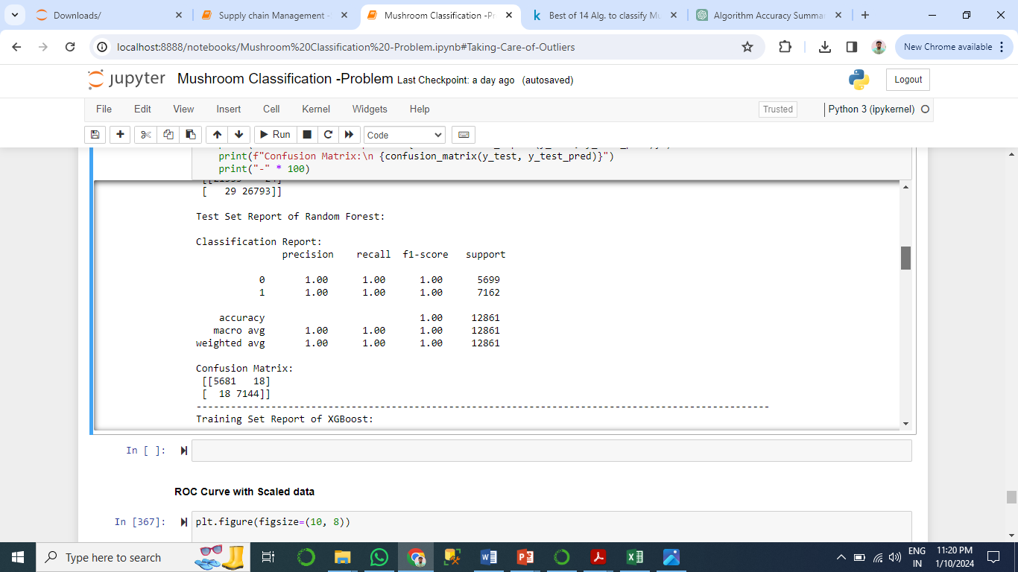
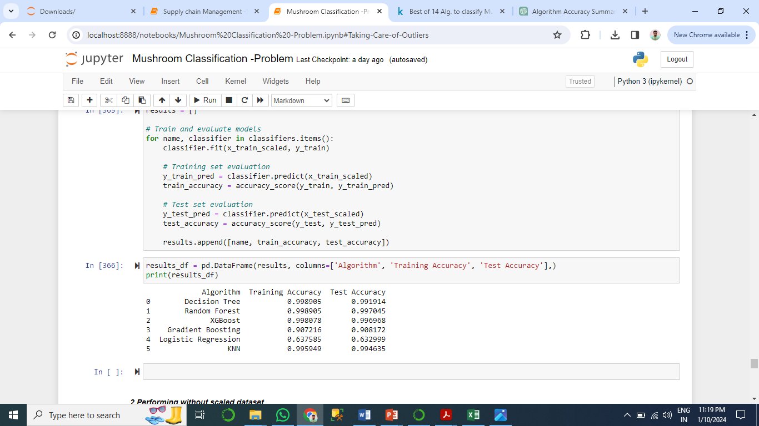
Predictions
As per the Model evaluation of training set ,the model has trained well where accuracy is touching 100% and In confusion matrix it showed Good result . The random forest model have worked very well after evaluating both the training and test dataset.Test set have worked better than the training dataset.
Data has been trained with Decision Tree, Random Forest, XGBoost,Gradient Boosting,Logistic Regression, KNN(K Nearest Neighbour . All Ensemble model has perfomed very well.Apart from Logistic Regression Ensemble KNN Model has been performed well with the Scaled Dataset.

Slide 21
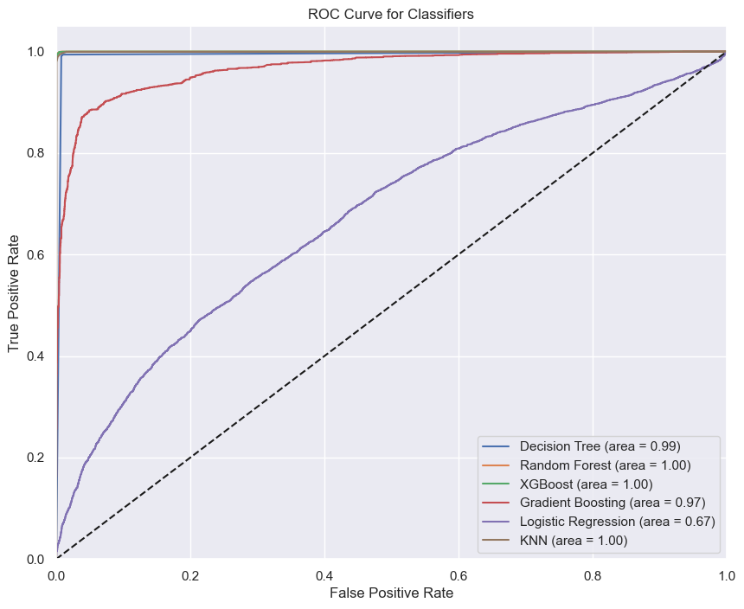
ROC Curve
The ROC Curve is the tools to measure the performance of the model .
It can be only used for Binary Class classification problem.
The ideal position of the ROC curve is the left upper corner where TPR is 1 and FPR is 0.
Here Almost all the algorithm peformed well except Logisitc Regression.

Slide 22
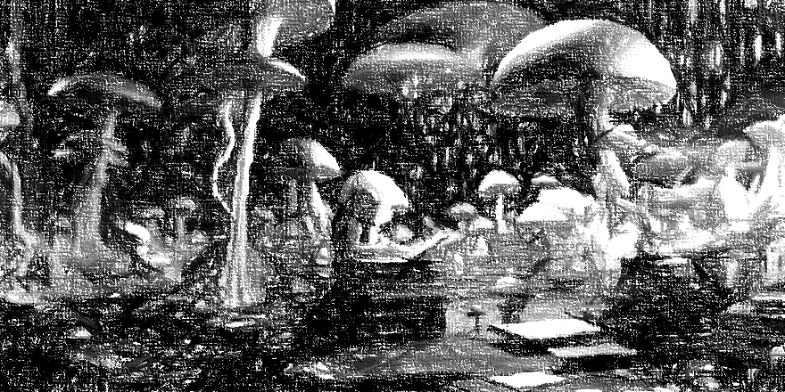
06
Conclusion & Recommendation

Slide 23
Conclusion & Recommendation
Conclusion
1.The Random forest classifier algorithm gives the best results as both train and test are not deviating and also the the accuracy score are best in both Train and test cases.By using the same model the Mushroom foragers can distinguish the poisonous one.
2.Explored the data, we delved deep into its nuances. with visualization techniques also with pandas profiling, we unraveled missing values, scrutinized distribution patterns, and painted a vivid picture of our dataset. The enchanting heatmap unveiled relationships between variables, and the seaborn count plots revealed the distribution of categorical variables across different featuers of mushrooms.
Recommendation
1. As per the analysis Mushroom family of Paxilus , Stropharia, Cropidots, saddle cup, Entoloma, Cortinarius, Earpick, Helly Disc are belongs to poisonous mushroom.
2. Mushroom which are found in the area of Grasses, Heaths and Paths are unknown and considered unsafe to consume for health.
3. Mushroom Forager should be careful while plucking mushroom by checking the color of its spore color .The poisonous mushroom spore colors are Pink, Black, Green, Brown , Purple.
4. Watch out for Veil-Colour as well are which are Black, Red, Brown, Purple.
Stricktly avoid Mushroom having stem color Pink, Yellow, Green, Pink, Black and having Club,Rooted type stem roots which indicates poisonous Mushroom.
Check the Cap Surface it shoudn’t be silky, Fibrous, Sticky Grooves which lead to Poisonous Mushroom
Use Small Garden towel and hand weeder while going to foraging.

Slide 26
THANK YOU

